Slide 1
We are revising atomic structure and radiation
TRACK WITH ME
READ WITH ME
Students will be able to:
Demonstrate their understanding of previous topics
Name the different types of nuclear radiation
State the properties of each type of nuclear radiation

Slide 2
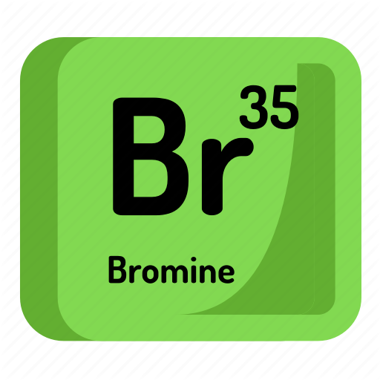
Repeat the opposite word/phrase.
ELEMENT
A SUBSTANCE THAT CONTAINS ONLY ONE TYPE OF ATOM

Slide 3
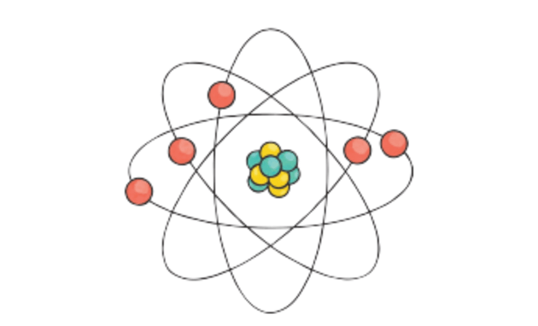
Repeat the opposite word/phrase.
ATOM
THE SMALLEST PARTICLE OF A CHEMICAL ELEMENT THAT CAN EXIST.

Slide 4
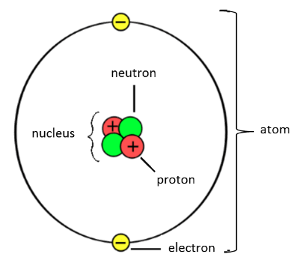
The structure of an atom
An atom is made up of protons, neutrons and electrons.
Protons and neutrons make up the nucleus which is at the centre of the atom.
Electrons are found in shells (or orbitals)around the outside of the nucleus.

Slide 5
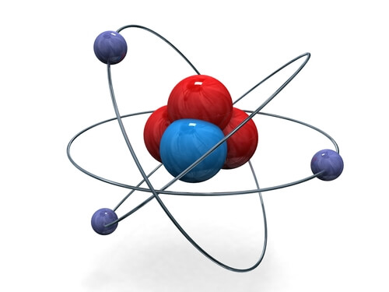
The structure of an atom
Atoms are made up of three subatomic particles: protons, neutrons and electrons.
The nucleus (centre) of an atom is made up of protons and neutrons.
The electrons orbit around the outside of the nucleus in shells.

Slide 6
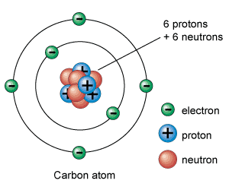
Charges!
A proton has a positive charge
A neutron has no charge
An electron has a negative charge

Slide 7
Charges!
A neutron has no charge
An electron has a negative charge
A proton has a positive charge

Slide 8
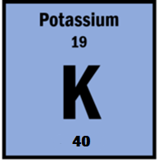
Repeat the opposite word/phrase.
ATOMIC NUMBER
THE NUMBER OF PROTONS IN AN ATOM

Slide 9
Repeat the opposite word/phrase.
MASS NUMBER
THE NUMBER OF PROTONS AND NEUTRONS IN AN ATOM

Slide 10
Atomic Number and Mass Number

Slide 11

Calculating the number of neutrons
40 – 19 = 21 neutrons

Slide 12


Types of Radiation
Alpha Particles: Identical to a helium nuclei.
4
2
He
Beta Particles:
Electrons emitted as radiation.
0
-1
e
γ
γ
Gamma Rays:
Emitted as a wave, not a particle.
0 0

Slide 13
Types of Radiation
Gamma Radiation:
Emitted as a wave, not a particle.
Beta Radiation:
Electrons emitted as radiation.
Alpha Radiation Identical to a helium nuclei.

Slide 14
Types of Radiation
4
2
He
Alpha
γ
0 0
Gamma
0
-1
e
Beta

Slide 15
Strength of Radiation
Alpha Radiation
Beta Radiation
Gamma Radiation
Sheet of Paper
Sheet of Aluminum
Thick Concrete Wall

Slide 16
Strength of Radiation
Gamma - Can only be stopped by lead or thick concrete
Beta - Can travel through paper but is stopped by aluminium
Alpha - Stopped by thin paper or a few centimetres of air

Slide 17
We are learning about atomic structure
TRACK WITH ME
READ WITH ME
Students will be able to:
Draw and label the structure of an atom
Determine the number of protons, neutrons and electrons in an element
Classify substances as elements, compounds, and mixtures.

